Slide 1
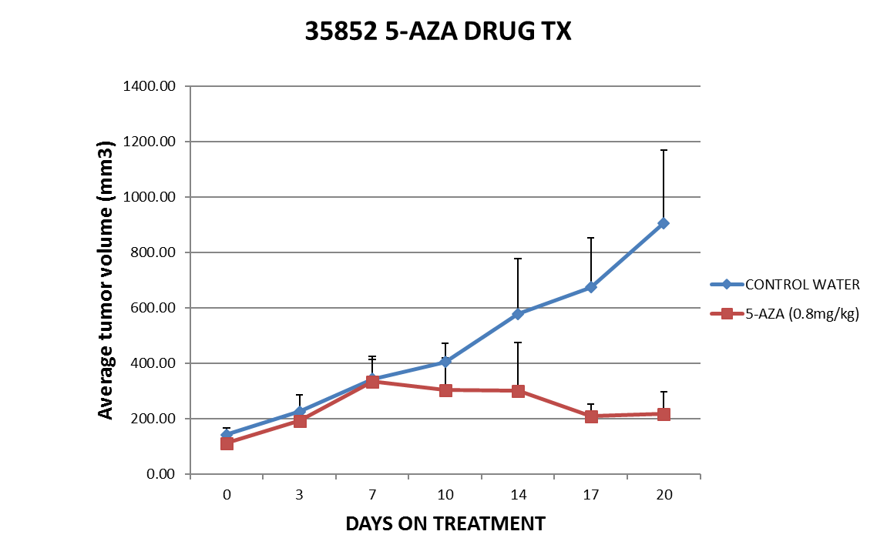
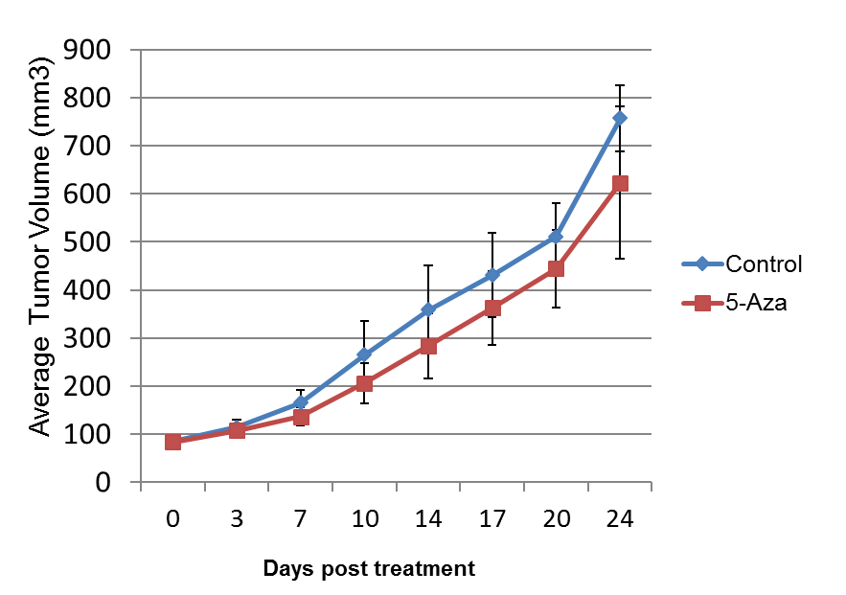
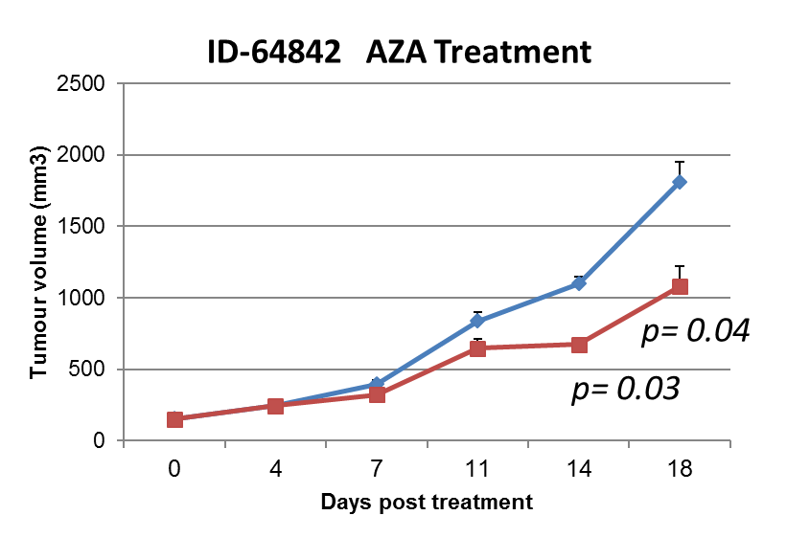
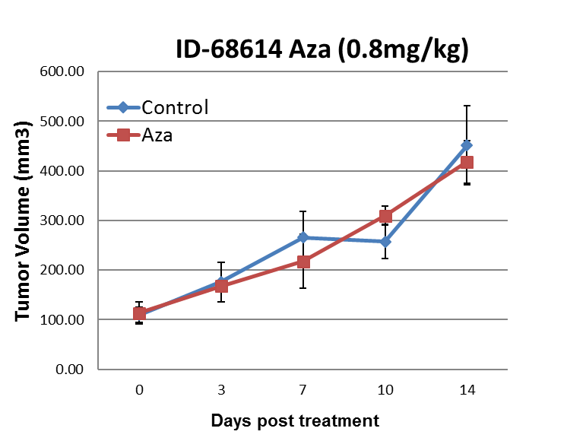
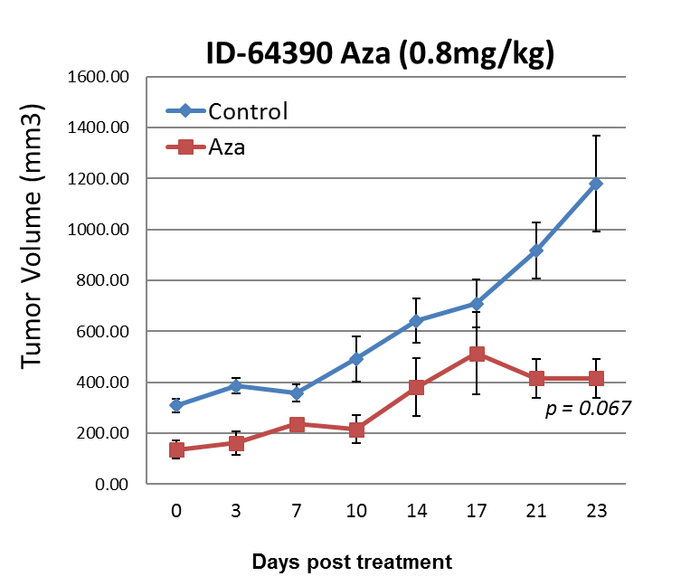
PDX-Model and OSCC Cells – 5-AZA Treatment
Responders
Non- Responders

Slide 2
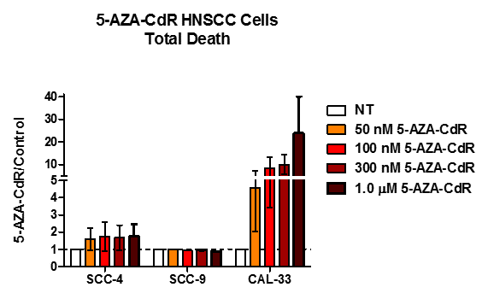
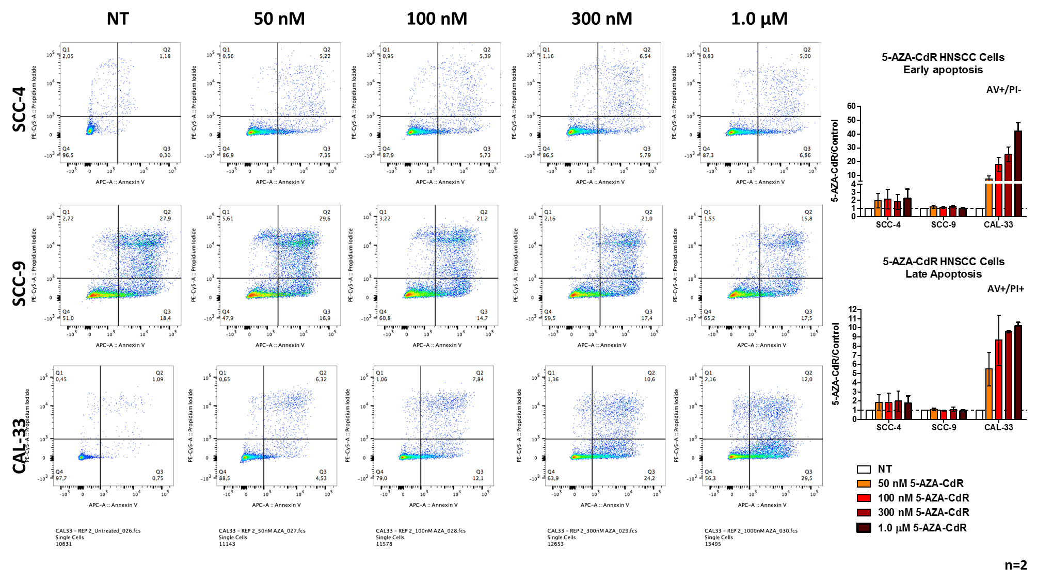
5-AZA Treatment
Death Rates: AnnexinV/PI Staining
AV+/PI-; AV+/PI+;AV-/PI+

Slide 3
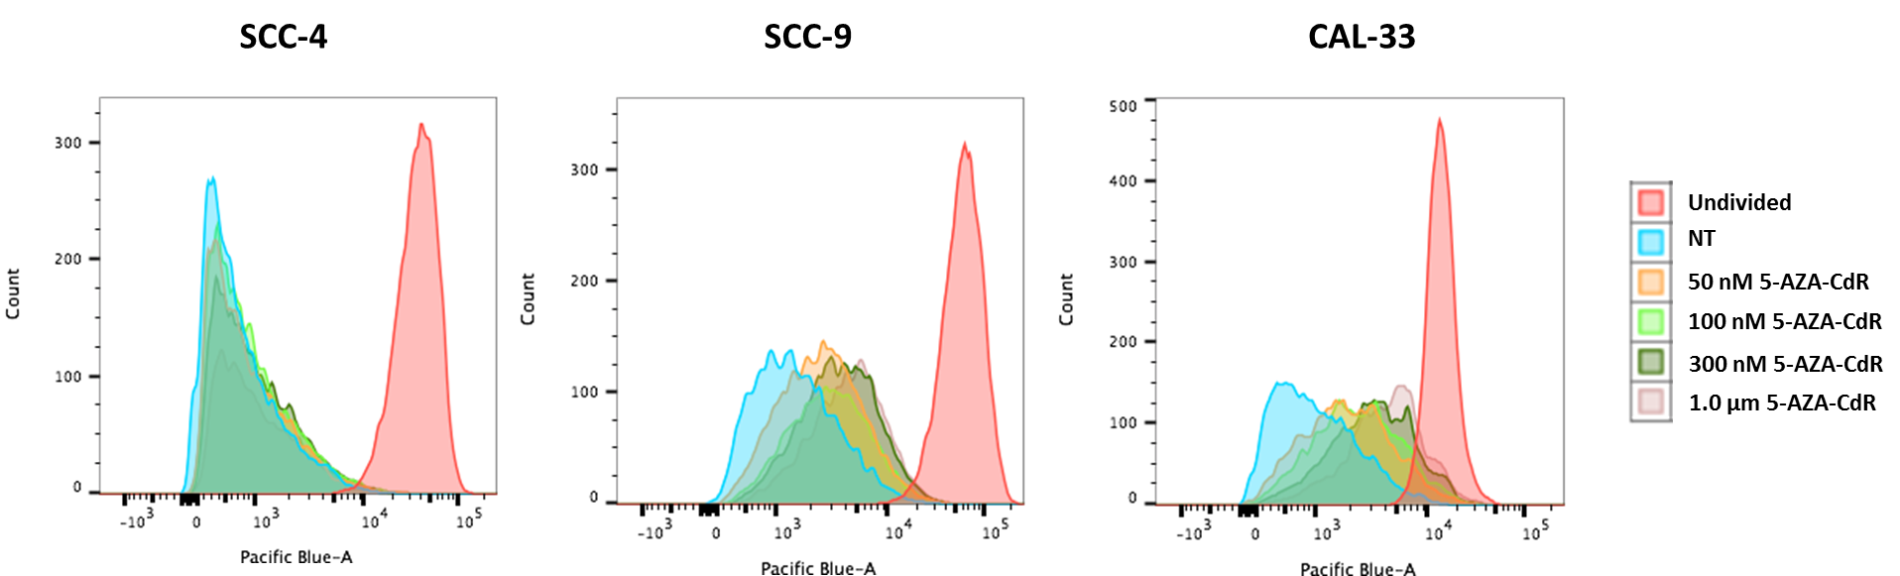
5-AZA Treatment
Proliferation Assay: CTV Staining
CTV Staining
Plate Cells
D0
D1
D2
D3
D4
D5
Add 5-AZA
1st dose
Add 5-AZA
2nd dose

Slide 4
5-AZA Treatment

Slide 5
5-AZA Treatment

Slide 6
RNAseq – Done (PDX-Tumors and OSCC Cells)
EPIC Methylome – Done (PDX-Tumors and OSCC Cells)
Integrated Analysis
Modulate pathways involved in 5-AZA response and resistance
In vitro assays
KD
Transductions
In vivo assays
PDX-Tumors
Inhibitors agents
Supervised Analysis
Unsupervised Analysis
Viral Mimicry Signatures
and Response for 5-AZA
Clusters of responders and non-responders?
Embryogenesis-related Pathways and Response for 5-AZA
What pathways can discriminate responders and non-responders
Enrichment analysis to see what pathways can discriminate responders and non-responders

